Slide 1
Pricing of Multiple-Event Coupon Paying CAT Bond
Author: Ganna,Reshetar

Slide 2
When we talk about terrorism risk, insurers with big natural catastrophe cover are looking to terrorism as a new area to underwrite.
Securitization of terrorism risk in a similar way has become a real challenge , since the inherent uncertainties associated with terrorism risk and consequent difficulties in modelling and quantification of this risk.
Develop a framework for pricing of a multiple-event coupon paying CAT bond.
The model is the first to address theoretical issues of pricing of an insurance-linked security that derives its value based on two underlying processes: catastrophic insured property losses and catastrophic mortality.
The first study that develops a CAT bond with a multiple-event structure.

Slide 3
The author implements theoretical pricing of a multiple-event CAT bond in incomplete market setting using a representative agent pricing model.
The payoffs on the bond are linked to two types of underlying processes: catastrophic property losses and catastrophic mortality.
Along with natural catastrophes and man-made disasters, the model views terrorism risk as one of the main exposure risks that may effect the cash flows of the bond.

Slide 4
The model:
Focus on catastrophic property losses and on catastrophic mortality.
The cash flows of the bond are linked to two types of triggering events
The first type of event is associated with either catastrophic property damage or catastrophic mortality that is above a corresponding attachment level.
The second type of event is when both catastrophic property losses and deaths are above their respective attachment levels.

Slide 5
The CAT bond is a coupon-paying instrument. Investors lose their coupon payments when one of the two triggering events happens. The principal is fully at risk if both triggering events occur.
Assume that evaluation of the incurred catastrophe property losses and the number of deaths respectively is implemented by outside institutions.

Slide 6
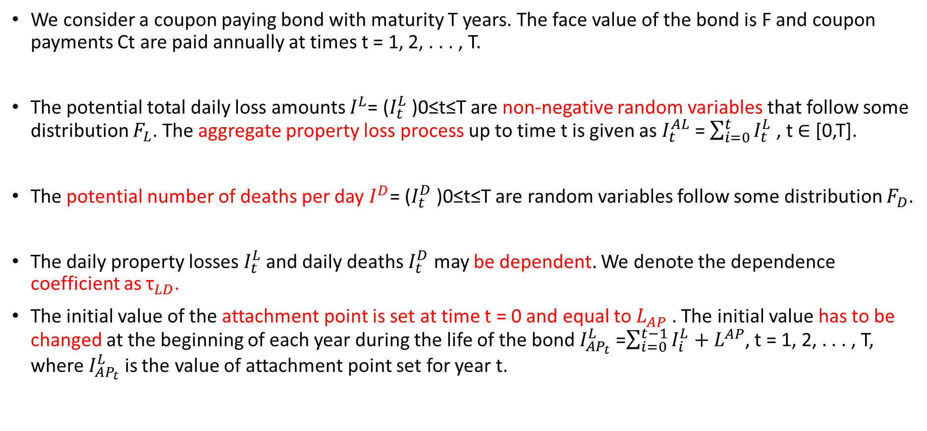
Assumptions
We consider a coupon paying bond with maturity T years. The face value of the bond is F and coupon payments Ct are paid annually at times t = 1, 2, . . . , T.
The potential total daily loss amounts $I^{L}$= ($I_{t}^{L}$ )0≤t≤T are non-negative random variables that follow some distribution $F_{L}$. The aggregate property loss process up to time t is given as $I_{t}^{AL}$ = $\sum_{i=0}^{t}{I_{t}^{L}}$ , t ∈ [0,T].
The potential number of deaths per day $I^{D}$= ($I_{t}^{D}$ )0≤t≤T are random variables follow some distribution $F_{D}$.
The daily property losses $I_{t}^{L}$ and daily deaths $I_{t}^{D}$ may be dependent. We denote the dependence coefficient as ${\text{τ}}_{LD}$.
The initial value of the attachment point is set at time t = 0 and equal to $L_{AP}$ . The initial value has to be changed at the beginning of each year during the life of the bond $I_{{AP}_{t}}^{L}$ =$\sum_{i=0}^{t−1}{I_{i}^{L}+L^{AP}}$, t = 1, 2, . . . , T, where $I_{{AP}_{t}}^{L}$ is the value of attachment point set for year t.

Slide 7
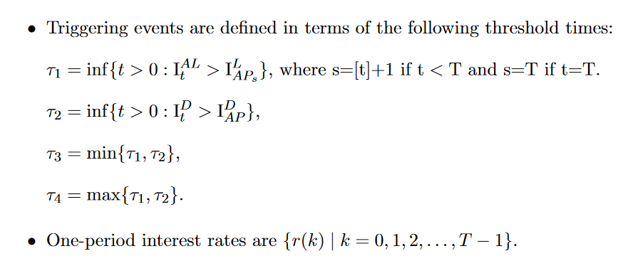

The attachment point for deaths is defined as a threshold number of deaths per day $I_{AP}^{D}$ . It stays at this level for the whole life of the bond.

Slide 8
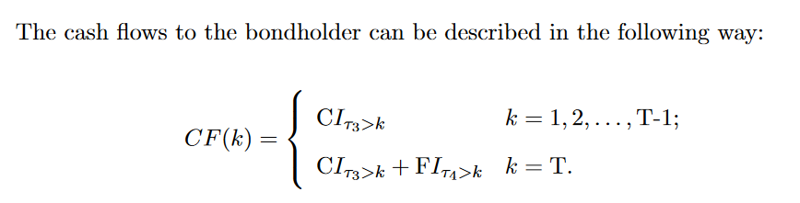
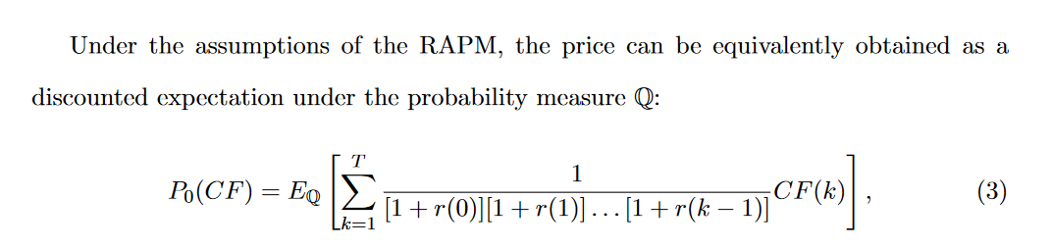

Slide 9
Conclusion:
It provides a numerical evaluation of the price of the bond under consideration. Authors implement Monte Carlo simulations of the bond price using the UK catastrophe data provided by Swiss Re.
Considering different catastrophe scenarios and compute corresponding prices of coupon-paying and zero-coupon CAT bonds.
The price of the bond has a direct relationship with threshold levels, but an inverse relationship with stronger positive dependence between losses and deaths.
There is an inverse relationship between the price of the bond and its time to expiration.
This relationship always works for a zero-coupon catastrophe bond, it may not always hold when a bond pays coupons.

Slide 10
When we talk about coupon paying CAT bond
Find a less responsive behavior of the bond’s price to changes in dependence compared to changes in the time to maturity.
For a coupon paying CAT bond, the impact of increase in attachment levels on the bond’s price dominates the effect of extended maturity. The opposite result is observed for a zero-coupon CAT bond.

